Slide 1

Use of Dublin Core metadata for describing and retrieving digital journals
Assumpció Estivill, Ernest Abadal, Jorge Franganillo, Jesús Gascón, Josep Manuel Rodríguez Gairín
Facultat de Biblioteconomia i Documentació
Universitat de Barcelona
International Conference on Dublin Core and Metadata Applications, Madrid, September 12-15

Slide 2
Summary
Background: the research group experience in applying Dublin Core metadata.
The Temaria portal project.
  Objectives, coverage and characteristics.
  Using the DC elements to describe and retrieve journal articles in the context of the project.
  Problems of applying DC to the description and retrieval of journal articles.
Conclusions.

Slide 3
Background: the research group experience in applying Dublin Core metadata
1999-2001: Web Resources and Metadata – Application of DC metadata to university web pages.
  Objectives: To check the difficulties of applying the system to university web pages; to check the effectiveness of the DC set to describe and retrieve web pages; to develop instruments for the application of metadata to web pages and their retrieval.
  Results: Data base structured according to the DC elements set; data entry form; archival classification to be applied to university web pages; guidelines for the application of DC in the context of the project.

Slide 4
Background: the research group experience in applying Dublin Core metadata
1999-2001: Web Resources and Metadata – Application of DC metadata to university web pages.
  General conclusions (2001):
    Simplicity/ambiguity of the simple DC;
    Complexity of the qualified DC requiring specialized knowledge for its application;
    A standard still under development;
    Using Dublin Core, by Diane Hillmann, was not available as a recommendation until April 2001.

Slide 5
Background: the research group experience in applying Dublin Core metadata
2000- : Application of DC metadata to articles in BiD: textos universitaris de Biblioteconomia i Documentació.
  First Spanish LIS journal to apply DC comprehensively –and possibly the first Spanish journal in any area.
  Not a research project, but a commitment to standards: the majority of search engines did not recognize DC tags and neither did the journal’s internal search software.
  Results: Metadata in the headers of some issues of the journal; metadata integrated in a database structured according to the DC elements (274 articles); search and retrieval for the journal and also integrated in the Temaria portal; other instruments developed for Temaria.
  Example: http://www.ub.es/bid/.

Slide 6
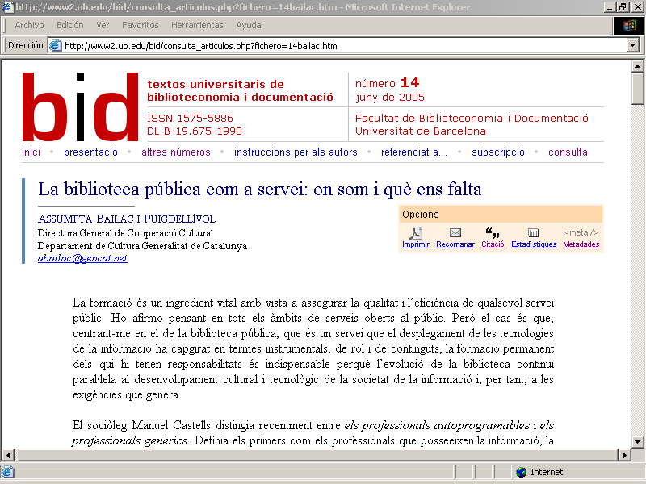

Slide 7
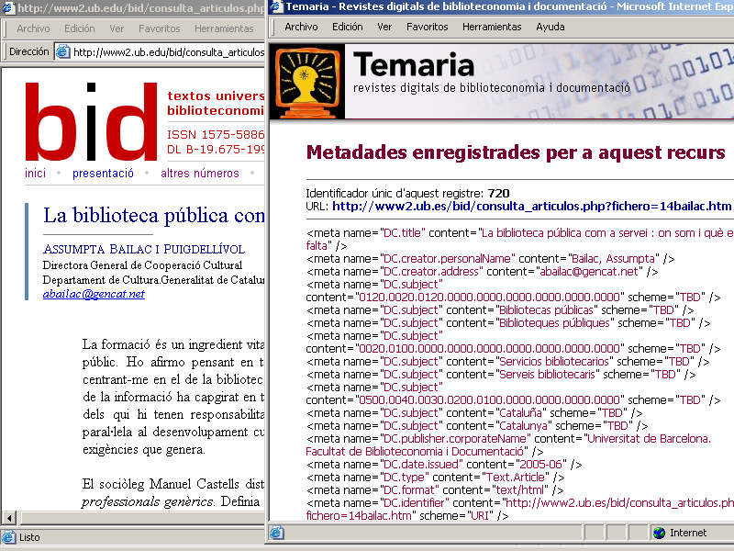

Slide 8
The Temaria portal project
Project started in 2004.
Objective: To facilitate searching for articles in Spanish LIS journals through the use of DC elements.
Coverage:
  Anales de documentación,
  BiD: textos universitaris de biblioteconomia i documentació,
  Cuadernos de documentación audiovisual,
  Cuadernos de documentación multimedia,
  Hipertext.net,
  Revista general de información y documentación.
  Currently 728 articles are searchable.
  Metadata for other titles are being prepared in expectation of its retrospective publication on the Web.

Slide 9
The Temaria portal project
Characteristics:
  Use of qualified DC to describe the articles.
  Commitment to standards and controlled vocabularies for the content of the DC elements.
  Adaptation of a specialized multilingual thesaurus to facilitate the indexing and retrieval of articles: Tesauro de biblioteconomía y documentación (CINDOC, 2002). Originally in Spanish and English, equivalents in Catalan were added in the context of the project. http://temaria.net/tesauro.php.
  Development of a user guide to assure that metadata is assigned properly and uniformly: http://temaria.net/guiaestil.php.

Slide 10
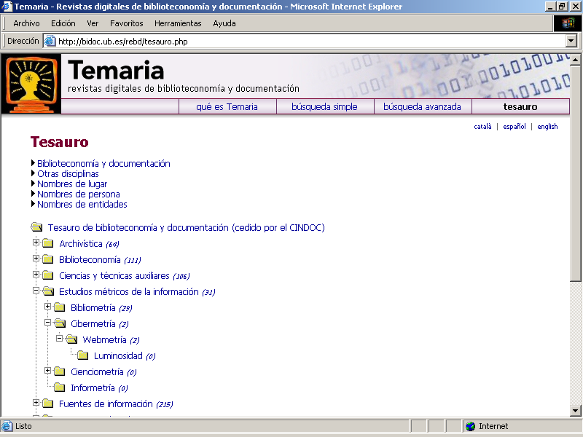
The Temaria project

Slide 11
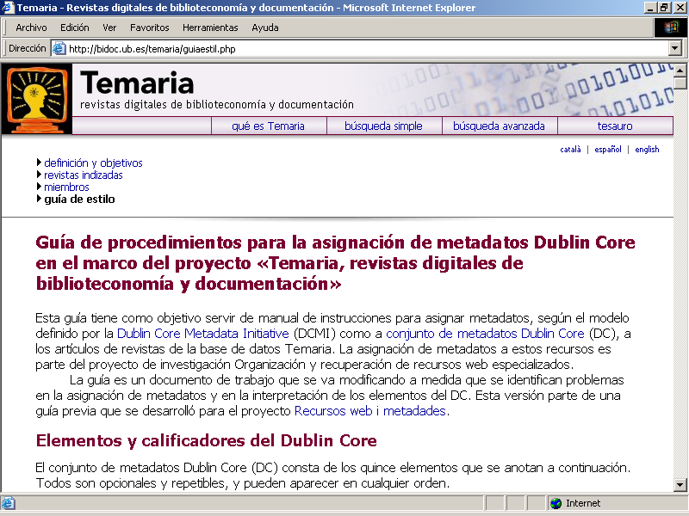
The Temaria project

Slide 12
The Temaria portal project
Using the DC elements to describe and retrieve journal articles in the context of the project.
  13 elements were designated as obligatory and repeatable: title, creator, subject, description, publisher, contributor, date, type, format, identifier, language, relation, and rights.
  The “coverage” element is optional, and the “source” element was removed.
  DC elements used in retrieval: title of the article, author (“creator” + “contributor”), subject, description, and identifier. Filters can be applied by title of journal, language, and date. http://temaria.net/avanzada.php.

Slide 13
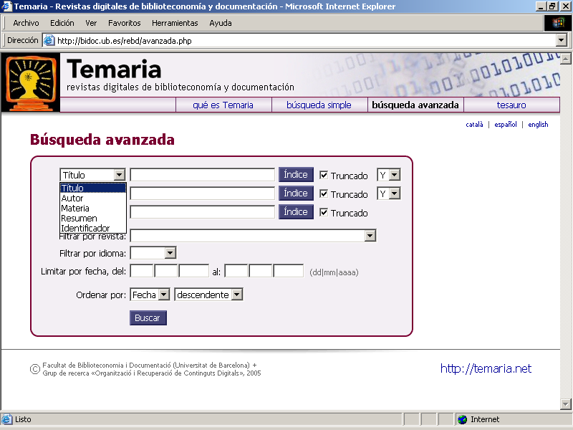
The Temaria project
Use of the DC elements for describing and retrieving journal articles in the context of the project.

Slide 14
The Temaria portal project
Using the DC elements to describe and retrieve journal articles in the context of the project.
  Qualifiers defined in the DCMI metadata terms are employed jointly with local qualifiers defined in the context of the project.

Slide 15
The Temaria portal project
DC elements | Element refinements (* Local refinements) | Coding schemes
creator publisher contributor | personalName* corporateName* address* | —
subject | — | Tesauro ByD (TDB) CDU 2000
description | abstract tableOfContents | —
date | issued | W3C-DTF
type | — | DCMI Type Vocabularie

Slide 16
The Temaria portal project
DC elements | Element refinements (* Local refinements) | Coding schemes
identifier | — bibliographicCitation | URI (URL, DOI, SICI...) —
language | — | ISO 639-2
relation | isVersionOf hasVersion is PartOf isFormatOf hasFormat | URI (URL, DOI, SICI, ISBN, ISSN...)
coverage | spatial temporal | ISO 3166 MARC 21 (043 codes) W3C-DTF

Slide 17
The Temaria portal project
Problems of applying DC to the description and retrieval of journal articles.
  Distinction between the “creator” and the “contributor” elements. Is it operative? Affiliation of creators coded as contributors as proposed in the Guidelines for encoding bibliographic citation information in Dublin Core metadata?
  Ambiguity in the definition of the “source” element. Should it be a qualifier of the “relation” element?
  Is the “coverage” element necessary since it deals with the spatial and/or chronological coverage of the resource and this also forms part of the “subject” element.

Slide 18
The Temaria portal project
Problems of applying DC to the description and retrieval of journal articles.
  Slow progress in the development of a formula for including the bibliographic citation of the journal that contains the article.
  Guidelines for encoding bibliographic citation information in Dublin Core metadata finally approved in June 2005. The Citation Working Group in operation since 1998.
  Formulas applied in the interim:
    Use of the “source” element.
    Development of a local field that did not appear in the user’s metadata record of the article.

Slide 19
The Temaria portal project
Problems of applying DC to the description and retrieval of journal articles.
  Formulas applied in the interim:
    Use of the “bibliographicCitation ” qualifier in the “identifier” element according to the guidelines DCMICite: a bibliographic citation Dublin Core structured value (DCSV) encoding scheme, that ultimately was rejected by the DCMI’s Usage Board.
    Use of the “bibliographicCitation” qualifier in the “identifier” element, according to the latest proposal of the Citation Working Group: Guidelines for encoding bibliographic citation information in Dublin Core metadata.
      Text citations.
      Machine parsable citations using the Open URL protocol.

Slide 20
Conclusions
Initial acceptance of Dublin Core as a metadata system by some subject portals (in general the were library related projects).
DC elements were also designated as the common metadata format by the Open Archives Initiative (OAI).
Standard recommended by several initiatives, such as the The ePrints UK Project.
In Spain, some LIS journals have adopted the DC metadata and it is a recommended standard of the e-revist@s project in the Tecnociencia portal.

Slide 21
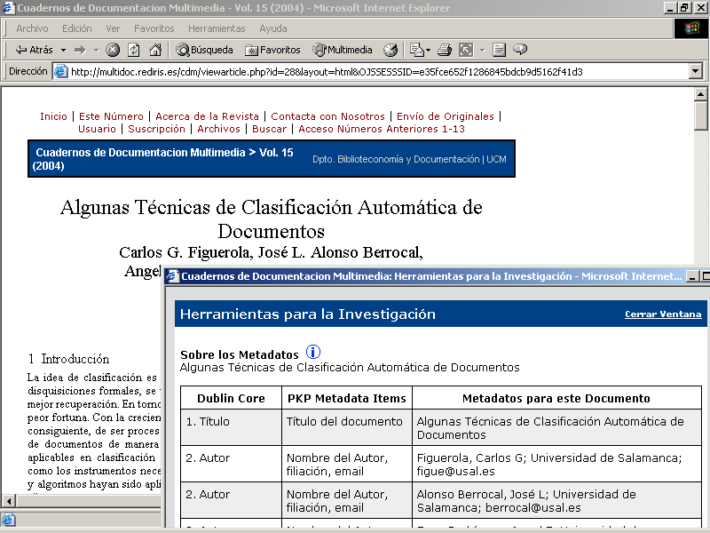
Conclusions

Slide 22
Conclusions
However...
  The developments of the DCMI have been very slow and sometimes inconsistent.
  Poor use of DC among data providers of the OAI:
    Of 100 data providers, 82 are using metadata. But what kind of medatada?
    71% provide only five elements: “creator”, “title”, “date”, “type” and “identifier”.
    44 providers use only the “creator” and “identifier” element in half of their products. Is that really DC metadata?

Slide 23
Conclusions
As for our project...
  Dublin Core has provided a standardized framework for it.
  It has facilitated the automatic inclusion of our metadata in the e-revist@s database of the Tecnociencia portal.
  It assures the interoperability of the metadata with other systems. For example, our metadata was very easily adapted to the Protocol for Metadata Harvesting of the OAI.
  However...
  It has slowed the process due to the lack of specifics for some elements and the absence, until recently, of clear guidelines for including bibliographic citations in the DC record.

Slide 24
Assumpció Estivill
Facultat de Biblioteconomia i Documentació
Universitat de Barcelona
estivill@ub.edu

